Slide 1
Item/doc 8.5/(4) – Approach for assessment and compliance review of centres
Third Session of the Infrastructure Commission
(INFCOM-3, 15-19 April 2024)
Michel Jean/president of INFCOM
18 April 2024

Slide 2
Content
Overview of centres under the responsibility of INFCOM
Directive of the Executive Council
Draft Decision 8.5(4)/1 – Establishment of the Study Group on Centres Assessment, Designation and Compliance Review (SG-ADCR)
Overview of Regional WIGOS Centres (RWCs)
Report of RWC pilot audit
Draft Decision 8.5(4)/2 – Interim approach for assessment of Regional WMO Integrated Global Observing System Centres (RWCs)

Slide 3
Overview of centres
WIGOS
Regional WIGOS Centres (RWCs)
Regional Instrument Centres (RICs)
Regional Marine Instrument Centres (RMICs)
World Radiation Centres (WRCs)
Regional Radiation Centres (RRCs)
WIS
Global Information System Centres (GISCs)
Data Collection or Producing Centres (DCPCs)
National Centres (NCs)
WIPPS
WIPPS Designated Centres (WMCs, RSMCs)

Slide 4
Directive of the Executive Council
RWCs: Resolution 12 (EC-73) - Regional WIGOS Centres audit process:
Requests INFCOM, in collaboration with the regional associations, to further develop the RWCs Audit Process as standard and recommended practices and procedures of the WMO Technical Regulations (WMO-No. 49), Volume I.
RICs: Resolution 17 (EC-73) - Strengthening Regional Instrument Centres and the process for designation, assessment: Requests INFCOM, in collaboration with the regional associations, to further develop the RICs audit process to be in line with the standard and recommended practices and procedures described in the Technical Regulations (WMO-No. 49), Volume I.

Slide 5
Rational for the establishment of SG
Audit is one demonstrated ways to ensure that the quality management system is implemented in operational centres.
Significant human and financial resources are required to develop and maintain a robust framework for audit, such as an audit programme, and to conduct such audit.
The Commission needs to consider feasibility of conducting such audit for various types of centres, under the responsibility of INFCOM, and the possibility to use other assessment and compliance review processes that can be implemented with less resources.

Slide 6
Draft Decision 8.5(4)/1 (INFCOM-3)
Draft ToR of SG-ADCR
SG-ADCR will:
Provide the interpretation of the provisions on the demonstration of compliance of a Quality Management System and requirements for audit of the Annex to Part VII (1.4) of the Technical Regulations (WMO-No. 49) Volume I – General Meteorological Standards and Recommended Practices, and provide draft amendments to clarify the provisions if necessary;
Assess the financial and operational feasibility of the RWC audit programme for all RWCs to be designated in all Regions;

Slide 7
Draft Decision 8.5(4)/1 (INFCOM-3)
Draft ToR of SG-ADCR
Assess the possibility to use alternative performance assessment mechanisms such as user feedback, annual status reports submitted by centres and statistics of objective monitoring systems;
Draft generic principles for the process(es) for centres assessment, designation, and compliance review, including generic principles for certification and accreditation, that are financially and operationally feasible for all types of centres under the responsibility of INFCOM in the long-term;
Draft a recommendation on the substructure of INFCOM to support the development and implementation of the processes according to the generic principles.

Slide 8
Background, concept and ToRS of RWCs
The concept of RWCs was proposed by ICG-WIGOS in 2017, published in the Guide to WIGOS 2018 edition
Basic functions of the RWCs:
regional coordination, guidance, oversight and support to WIGOS implementation and operational activities at the regional and national levels
The operational implementation of RWCs was one of the 6 highest priorities of WIGOS Initial Operational Phase 2020-23
Since 2019, based on Member’s volunteer applications, RAs have designated various RWCs to cover either the entire Region or sub-regions
RWCs are hosted and operated by Members either in insulation or as network of nodes
Regional Associations (RAs) designate RWCs (pilot/operational)

Slide 9
Functions of RWCs
The RWCs mandatory functions are as follows:
(Regional) WIGOS metadata management (work with data providers to facilitate collecting, updating and improving the quality of WIGOS metadata in OSCAR/Surface),
(Regional) WIGOS performance monitoring, evaluation and incident management (WIGOS Data Quality Monitoring System – WDQMS) and follow-up with data providers in case of data availability or data quality issues.
Optional functions
Depending on available resources and regional needs, one or more optional functions may be adopted, e.g.:
assistance with the coordination of regional/subregional and national WIGOS projects;
assistance with regional and national observing network management; and
support for regional capacity development activities.

Slide 10
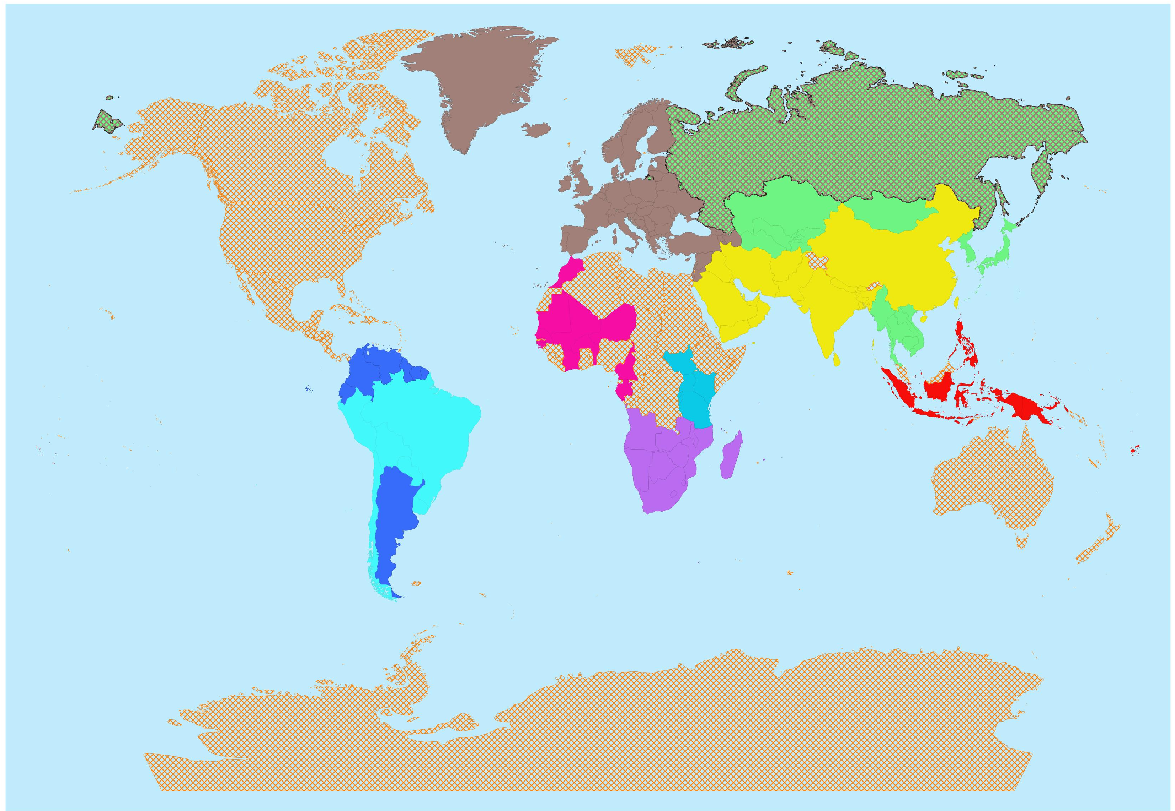
Status of RWCs establishment
RA IV:
Started pilot phase in Dec 2023 (BCT, Canada, Costa Rica, Trinidad & Tobago, USA)
RA VI:
Automatic monitoring function since 2018 (EUMETNET);
Establishment under progress with nodes hosted by Bosnia & Herzegovina, Kazakhstan, Romania, Türkiye and EUMETNET, plus Russian Federation and Belarus
RA III:
Pilot phase operations since May 2020 (Argentina and Brazil)
RA I:
East Africa - Pilot phase since July 2020 (Kenya and Tanzania),
Southern Africa - pilot phase since March 2021 (South Africa)
West Africa - pilot phase since September 2021 (Morocco)
RA V:
Initial pilot phase since October 2022 (Indonesia and Fiji)
RA II
RWC Beijing and RWC Tokyo, fully operational since September 2021

Slide 11
The RWC Audit Programme
Drafting an audit process and programme was required for RWCs since no common WMO process exists for WMO operational centres
ET-WTR (Expert Team on WIGOS Tools and RWC Operations, SC-ON) and ET-AC (Expert Team on Audit and Certification, SC-IMT) worked jointly on an audit programme for RWCs in pilot mode, as part of the process to designate RWCs in operational mode
as outlined in WIGOS Guide (WMO-No. 1165), chapter 8
Following various inputs, including concerns with resources and feasibility to perform on-site audits, an audit programme for remote audits was developed which includes:
Audit Objective, Audit Scope, Audit type, Audit Method, Scheduling, Audit Criteria, Risks and opportunities and actions to address them, Audit Team/Auditors, Relevant doc information
It also includes relevant documents essential to conducting RWCs audits:
Template Audit Notification
Template Audit Report
Audit Schedule
Self-Assessment Questionnaire

Slide 12
The Audit Programme and the pilot RWC audit (Argentina)
The RWCs audit programme was tentatively endorsed by INFCOM-Execs in November 2023
It was used for conducting a pilot audit to RWC Argentina in January 2024
RWC Argentina was one with the longest period of pilot mode operations,
An opportunity to assess the virtual method, including technology for remote audit, as well as potential issues related to language barriers and differing time zones,
To check the feasibility, a test audit with RWC Argentina was previously conducted (December 2023)
The audit team for RWC-Argentina was composed by:
an auditor (member of ET-AC) as lead auditor
a subject matter expert (SME) (member of ET-WTR)
The audit lasted approximately 9 hours online (3 hours/day for 3 days)

Slide 13
Report of RWC pilot audit
(INFCOM-3/Inf. 8.5(4))
Results and lessons learned are summarized in INFCOM-3/Inf. 8.5(4)
Lessons learned from pilot audit, as a conclusion, remote audits are feasible and can be used for other future RWC audits.
Quality Management System (QMS) related items of RWCs audit programme were among the most challenging aspects of the RWC audit
Resources required to develop and conduct the RWC Audit Argentina
Audit competency of Lead Auditors and SMEs for RWC is essential to successfully conduct audits => requires training for future auditors and SMEs
Remaining open questions and tasks
Certification process
Discrepancies between WMO-No. 1165 and WMO-No. 49, Volume I, part VII
The future evolvement of the RWC audit process
Future RWC audits

Slide 14
Draft Decision 8.5(4)/2 (INFCOM-3)
Interim approach for RWCs Audit
To endorse the audit process to assess RWCs as an interim approach, until INFCOM-4
To establish audits teams to be composed by one auditor and one Subject Matter Expert (SME)
To follow a calendar of a maximum of four audits per year to be scheduled in consultation with Members hosting and operating RWCs in pilot mode
Revisit the RWC audit process in consultation with the new Study Group on Centres Assessment, Designation and Compliance Review (SG-ADCR)

Slide 15
Tentative sequence of RWCs audits
2024
South Africa
2025
Kenya
2026 and beyond
Brazil
Morocco
Tanzania
Indonesia
Fiji
British Caribbean Territories
Canada
Costa Rica
Trinidad and Tobago
USA
RA VI
RA I
Members should actively collaborate with the relevant RWCs, via their National Focal Points on the WIGOS Data Quality Monitoring System (WDQMS), and to nominate or to update their nominations as required, to make the operations of RWCs a success.
!

Slide 16
Thank you.
^{wmo.int}

